Slide 1

COMP47250: Team Software Project
PRESENTATION 4
6th JULY, 2020

Slide 2

Team Rocket
Aditya Krishnan 15316048
Apurva Deore 19200283
Ashwin Manikandan 19201000
Minaz Shaikh 19200200
Nripendra Singh 19200326
Sumit Kumar 19200701
Vishal Padma 19200174

Slide 3






Project objectives
Challenge 1: COVID-19
COVID-19 INTERACTIVE VISUALIZER

Slide 4
AIM Creation of a Web-based Chatbot Application and Map Visualizer.
Solve user queries regarding the COVID-19 pandemic across the world.
Create more awareness among people regarding the effects of the pandemic, specifically in the health sector.
Bot and power the map-based visualizations of the world which will be also deployed on the same application.
The chatbot aims to provide an accessible natural language interface to dynamic virus-related information
Visualizations aiding with the impact of information received and improving the overall experience of the application.
We plan to achieve two paramount features
CHATBOT
A chatbot which would answer user’s queries about COVID-19.
Eg: Symptoms of COVID-19?
INTERACTIVE MAP
visualizations that provide statistics about COVID-19 of various countries, which would also dynamically update based on user queries.
E.g. Total cases? Active cases?

Slide 5
Project Plan
After having achieved partial V1.2, lacking the integration of the chatbot with the front end pf the application, we aim to further breakdown tasks and reach goals into sprints and release versions. As part of the main non-trivial extension we would like to first refine the scope of the chatbot to being strictly restricted to information regarding Ireland.
Version 2.0 (7th July – 13th July’20)
Reviewing the Lex API and identifying the constraints to develop core intents which will be deployed from start to end. Integration of second API with the existing data.
Version 2.1 (14th July – 20th July’20)
Integration of the chatbot to the existing web application, With fine tuning the scope of the project to better accommodate the development process.
Version 2.2 (21st July – 28th July’20) 🡪 Milestone 2/Final Product
Refining the functionality of the application to better improve User Experience and streamlining of the paramount tasks (House the Chat-Bot and prepare the map visualizations) and preparation of final evaluation framework in preparation of user testing.

Slide 6
Roles
Aditya and Minaz (Front-End Team) Decide on the UI design and layout and functionality of the Webpage with the subsequent creation of Front-End.
Integration of the Front-End with the Back-End. Refine the Web page with improved functionality to help better the UX
Apurva and Vishal (Data and Visualization Team) Research on the second potential API required and write scripts for Data Collection.
Data Mining and Data Cleaning/Pre-processing as and when required.
NLP Processing for Text and research/deploy visualizations.
Ashwin (Cloud Deployment Team) Test/Deploy the required resources (Data Lake/ PostgreSQL/Data Factory/DB).
Create dummy scripts and trigger them using data factory pipelines.
Research on how to connect PostgreSQL to Front-end.
Sumit and Nripendra (Django Team)
Analyze for the risks involved and prepare .Net Backup
Prepare the structure of Lex API, and develop intents based on user requirements.
Creation of Back-End and integration with the front-end.

Slide 7
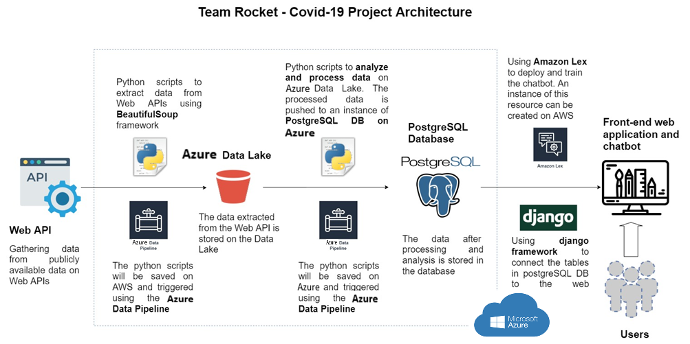
Architecture

Slide 8
DATA PLAN
Data to be considered
We are considering data from various APIs; We scoured the web for COVID-19 API’s or other implementations of centralized world data regarding the pandemic. We plan to consider two broad types : DYNAMIC and STATIC data. Once the data is collected and curated, we aim to filter the type of queries the bot is able to answer.
DYNAMIC / LIVE DATA
-Statistics of COVID-19 cases Per Country [Real Time Data, Updating regularly]
Total cases
Active cases
Recovered cases
Deceased cases
Tests done
https://api.covid19api.com/summary
https://api.covid19api.com/countries
https://raw.githubusercontent.com/microsoft/Bing-COVID-19-Data/master/data/Bing-COVID19-Data.csv
https://www.programmableweb.com/api/yatko-coronavirus-map-rest-api-v10https://api.quarantine.country/api/v1/summary/latest
As Part of fine tuning the scope of the project, we decided to prepare data of Ireland regarding the pandemic in greater detail to demonstrate the current scope of the project.
The refined irish data is aimed to demonstrate what type of data of each country we envision the final version of the application would contain for users to access.
Worked on collecting data that is specific to Ireland. Used the data provided by data.gov.ie
This data source provides us with the data focused on Ireland only. It provides the statistical data for Ireland’s 26 counties separately as well as for the country as a whole.
The columns it provides are : CountyName, Population, ConfirmedCases, Case by population, Confirmed/Deaths/Recovered, Hospitalized cases (Age-Group Related Statistics), Gender-wise COVID-19 cases, Reason of spread Categories.

Slide 9
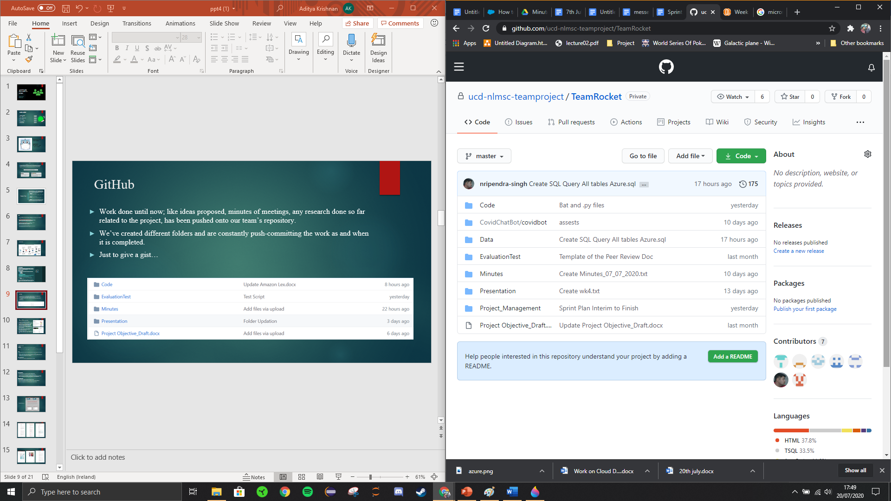
GitHub
Work done until now; like ideas proposed, minutes of meetings, any research done so far related to the project, has been pushed onto our team’s repository.
We’ve created different folders and are constantly push-committing the work as and when it is completed.
Just to give a gist…

Slide 10
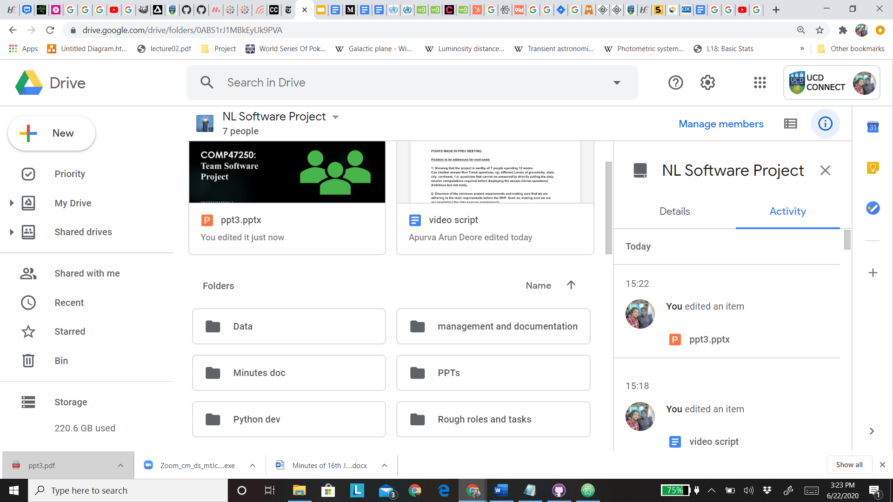
Team Management
Team progress managed by Sumit and Aditya:
Shared google drive folder which contains all the different folders for each team consisting of basically all of the data cumulated at one place for enhanced availability and accessibility, including the log of each MOM and documenting the progress of the team at each stage.
Conducting daily meetings via Google Meet and logging MOM of each meeting
We’re using Jira to outline each team member’s work, define sprints, plan the work to be done and the corresponding deadlines for them.
Just to give you a gist, you can see on the right; our Jira board with tasks allocated and our shared folder on Google Drive.

Slide 11
Progress So Far..
Front-End
Clean the front-end of the web application design and structuring the layout of the pages accordingly.
Researching potential features for better UX
Test deployment of bot on a web page, solving issues in relation to Django and node js.
Data
Integration of the summary data from the two main APIs and the final merged Dataset set for each country which will be later used in the visualization.
Working on Tableau with further visualizations for the newly curated data pertaining to Ireland. Some of the visualizations done so far are displayed in the following slides.
Test Evaluation Scripts
Creation of a User Test Case script template and a peer review template.

Slide 12
Cloud Architecture
Created a MySQL server hosted on Azure to connect using the MySQL Workbench
Instance of MySQL server was created to connect with the instance of Amazon Lex used to build the chatbot
A table ActiveCases was created on the server with the appropriate schema and the required data
The intents of Lex were successfully tested to fetch data present in ActiveCases
Lex development
Reorganise the structure to narrow the scope of the queries that is aimed to be fulfilled.
Prepare for development of a user intent for deployment from start to finish.
Intent of get country data for Active, confirmed and deceased cases successfully implemented.
Development of image generation with current intent.

Slide 13
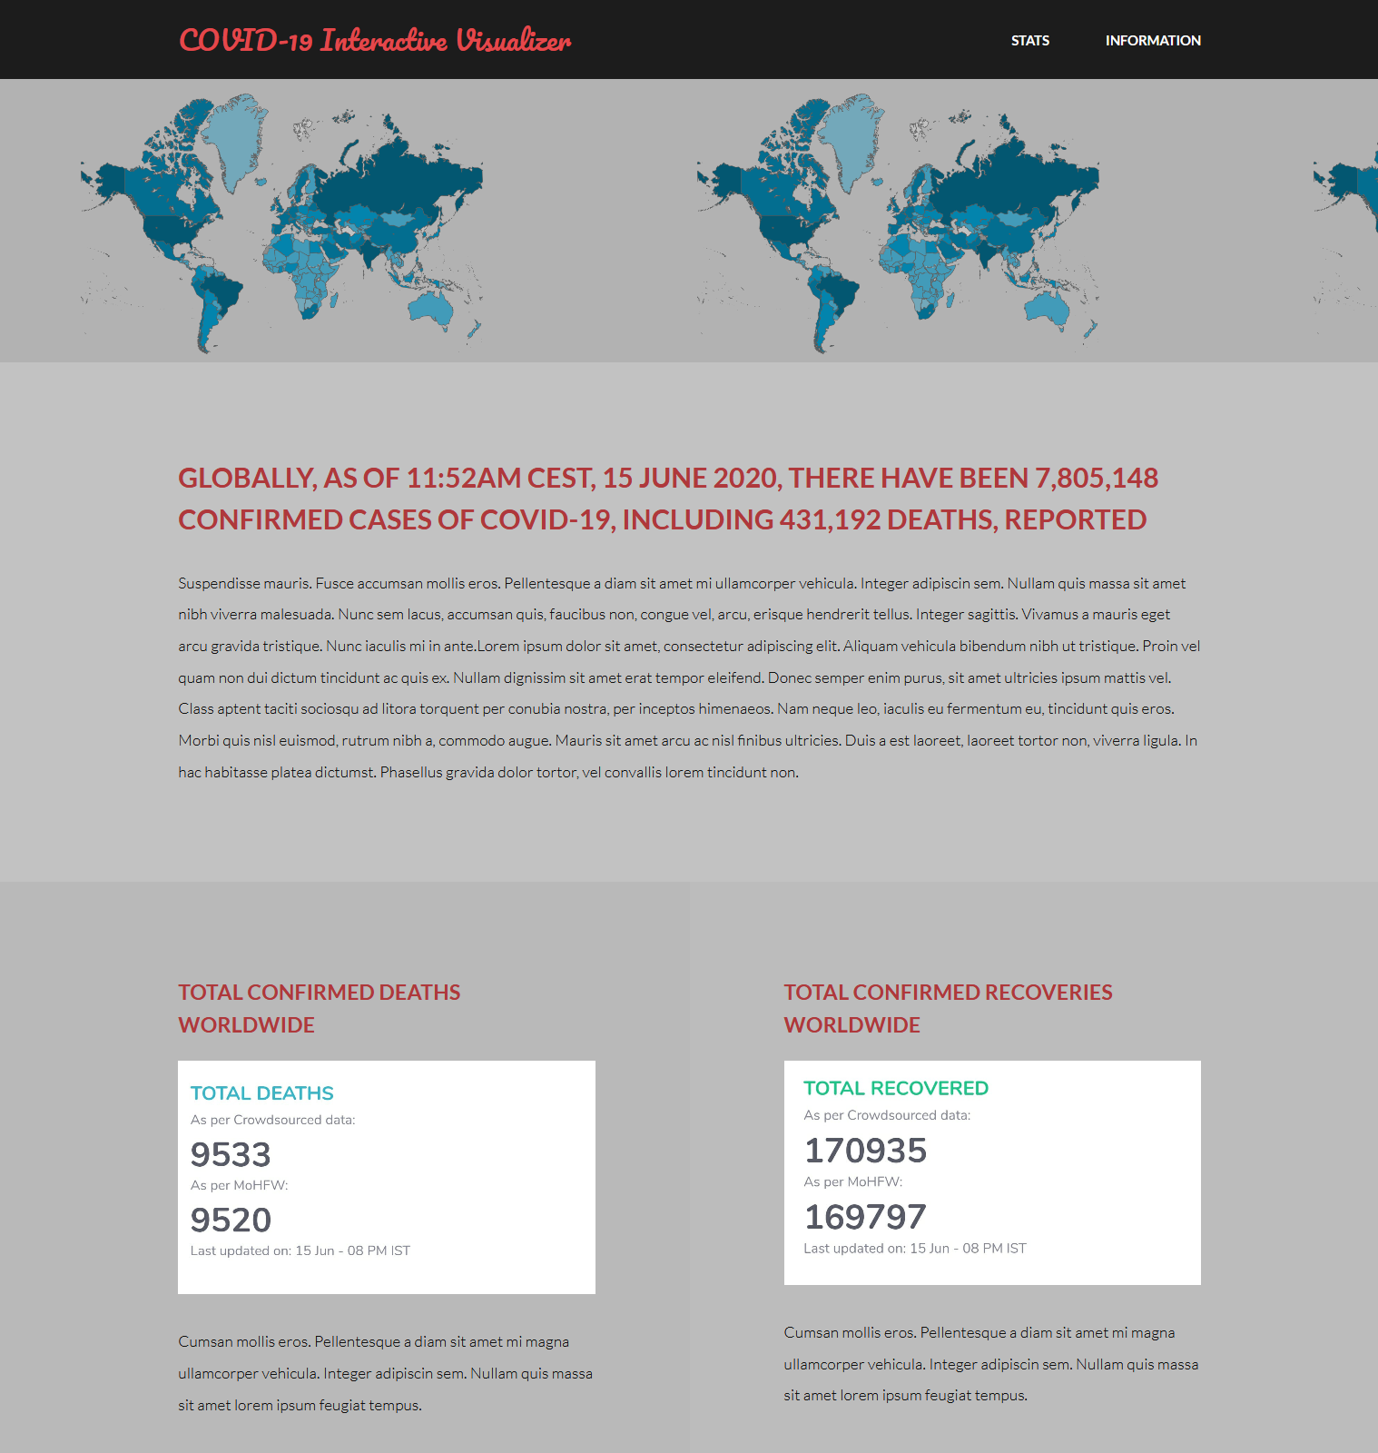
Just a gist of what our
web-page would look like!

Slide 14
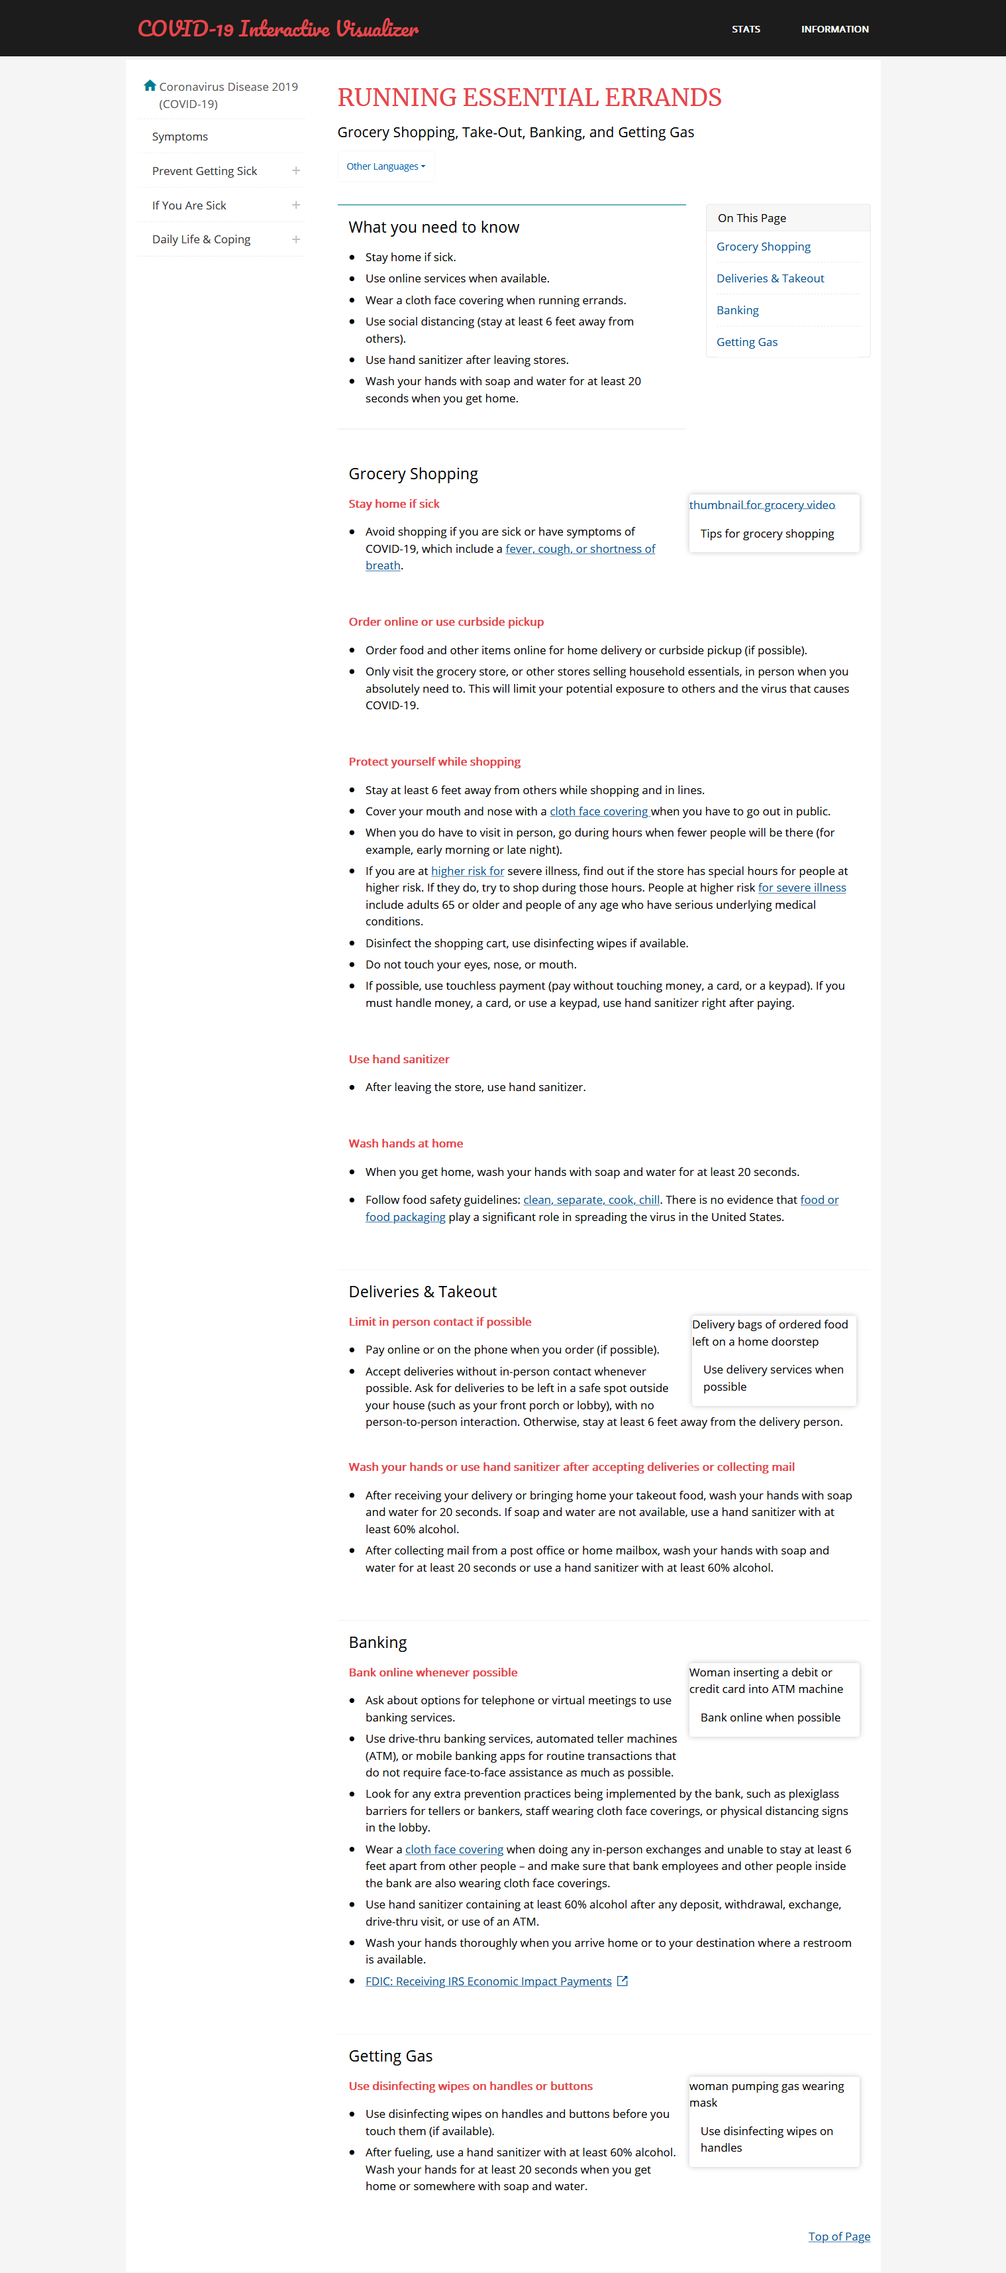
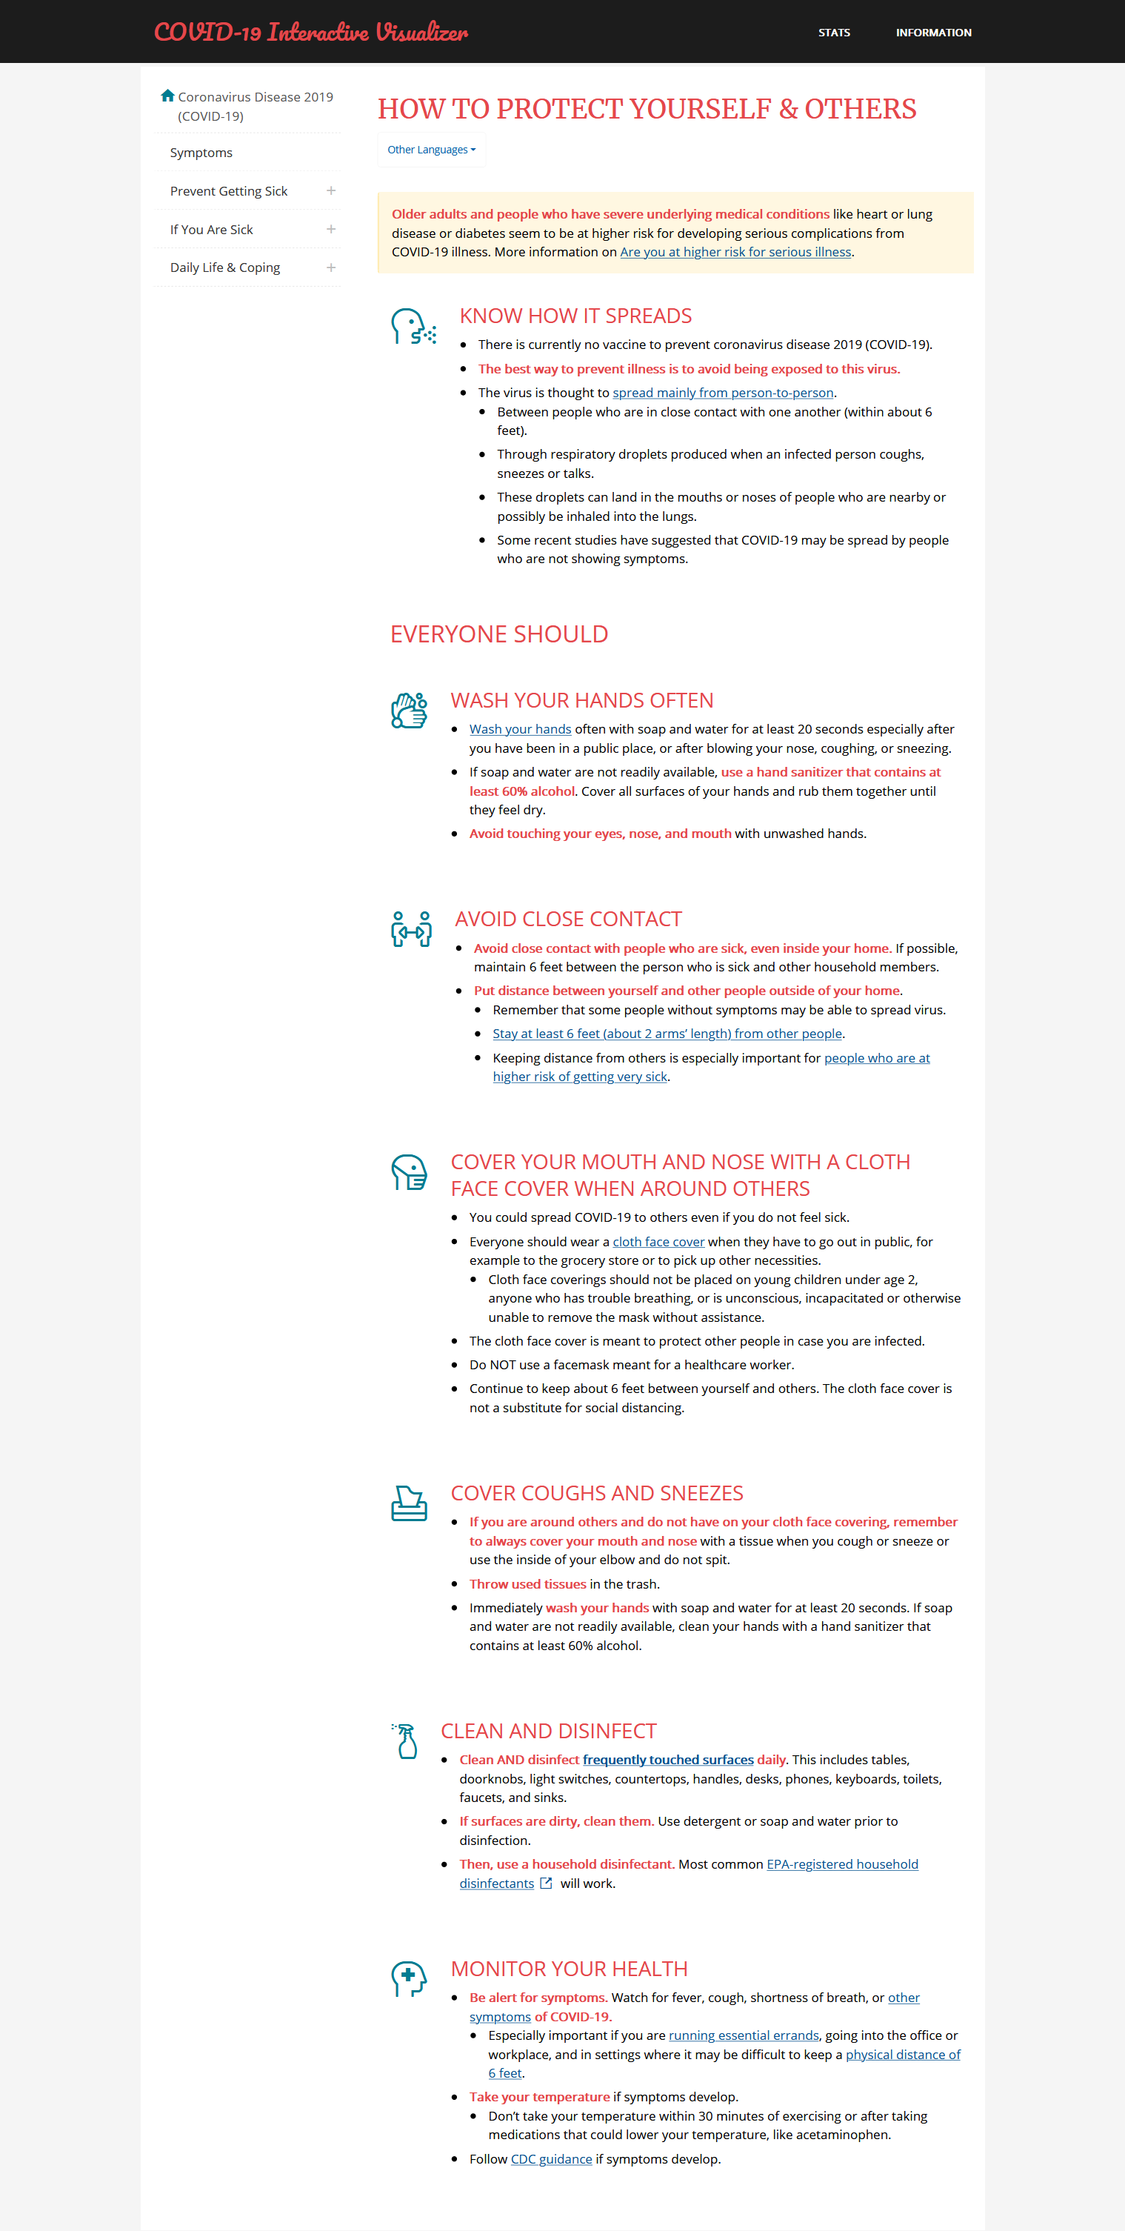
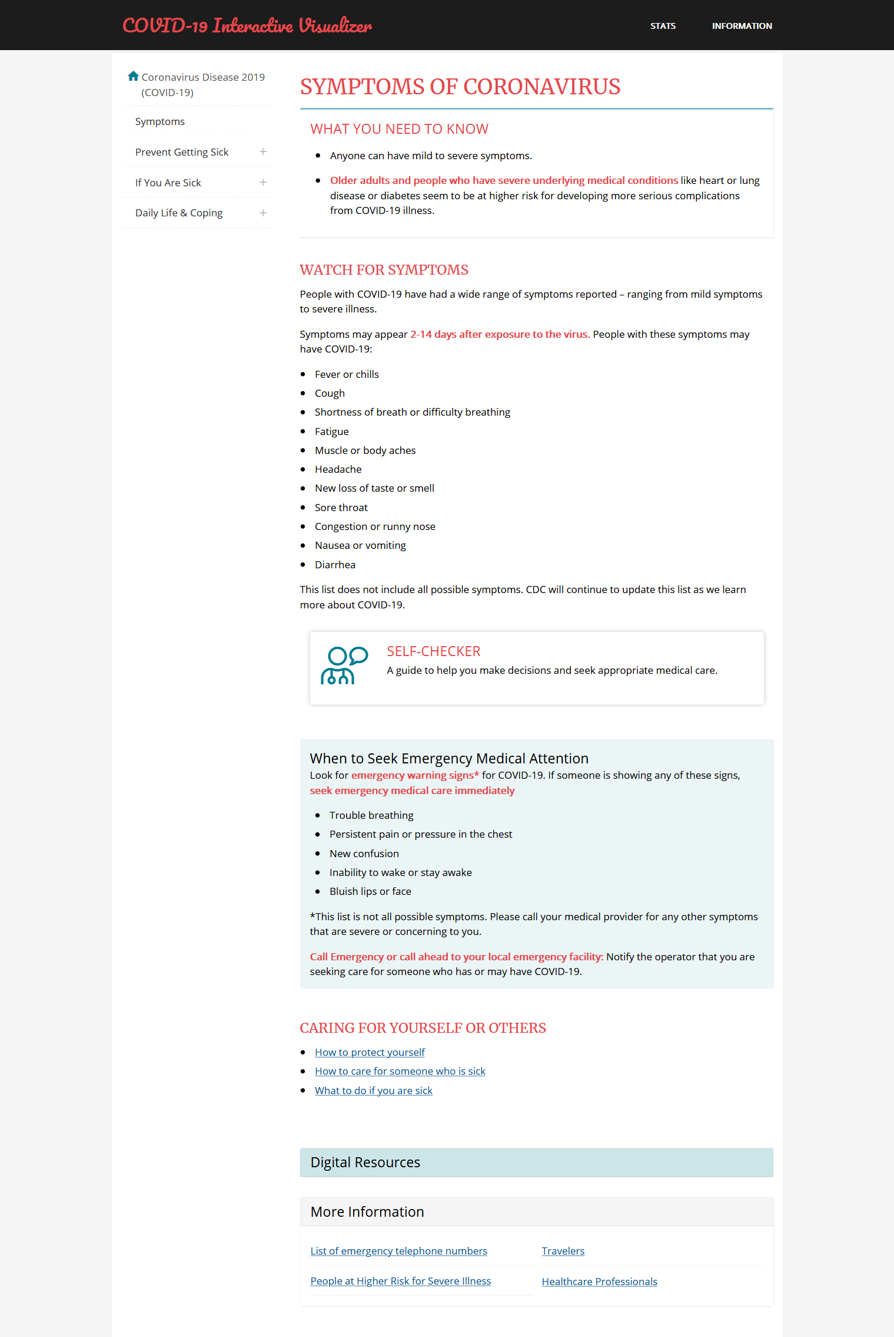

Slide 15
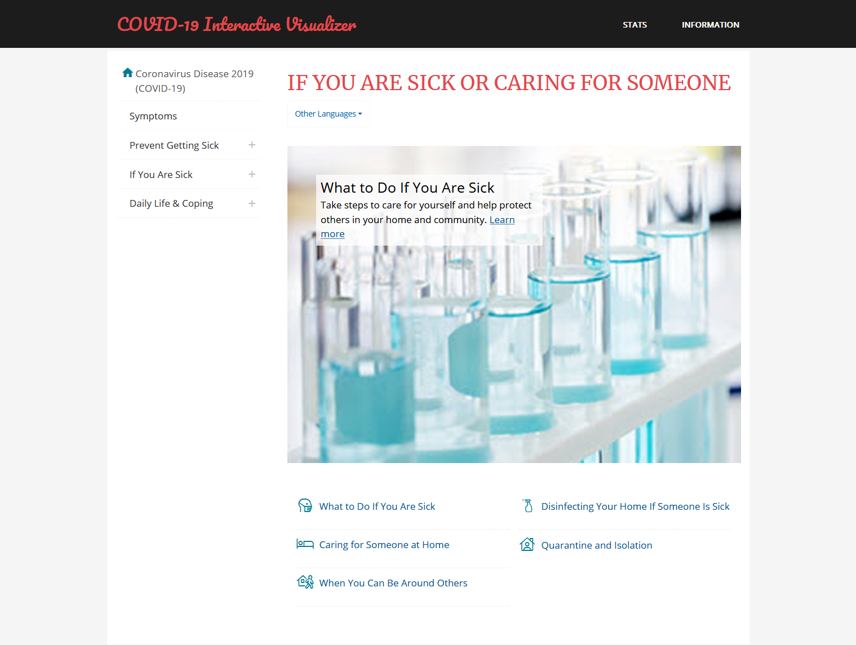
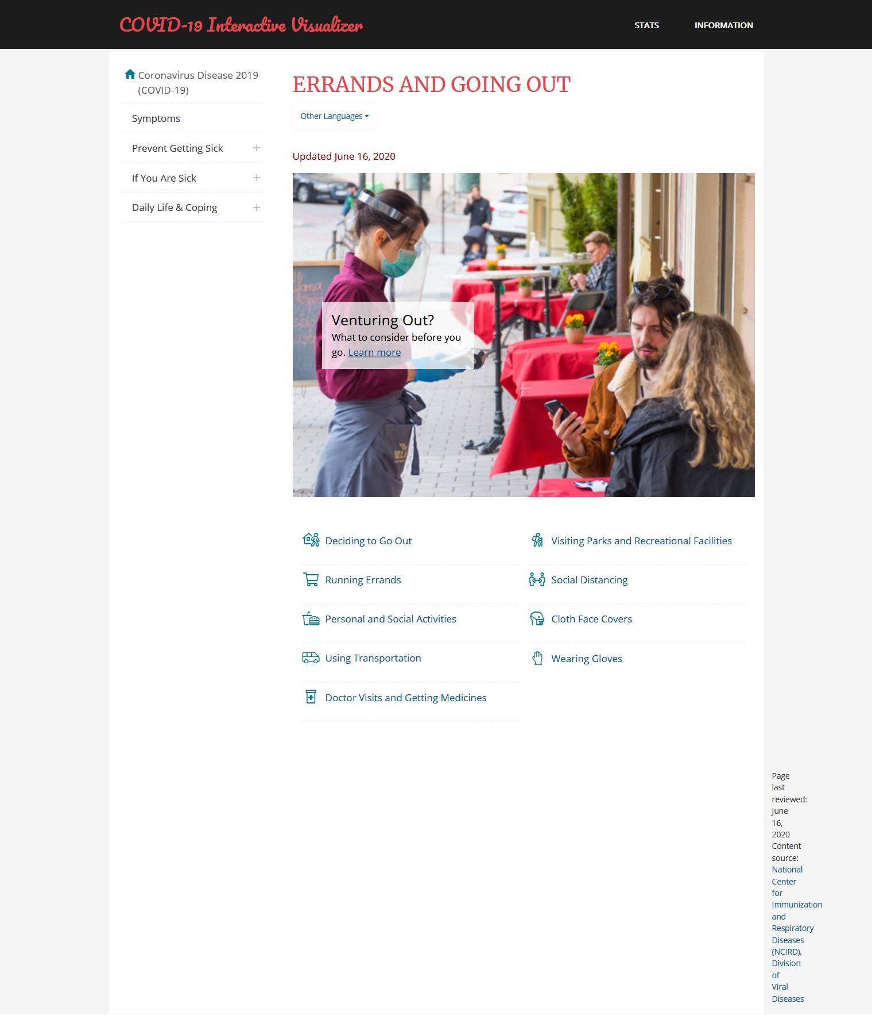

Slide 16
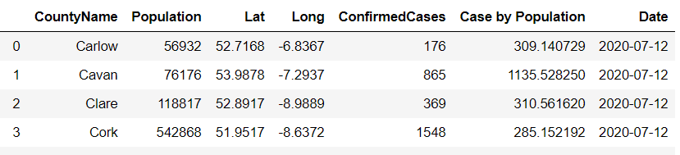
Dataframe1: It consists of the country’s population data (pertaining to each county) , confirmed cases of COVID-19 till date and Cases by population data.
Data & Visualizations

Slide 17
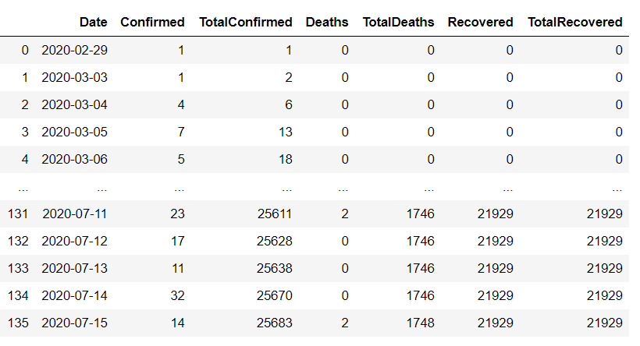
Dataframe2: This data frame consists of statistical Time series data revolving around the main types of cases.
Several other data frames have been collected to focus more into Ireland specific visualizations.

Slide 18
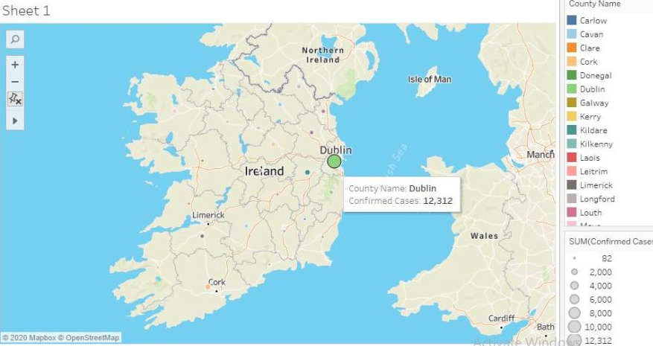
County wise description of statistics in Ireland.

Slide 19
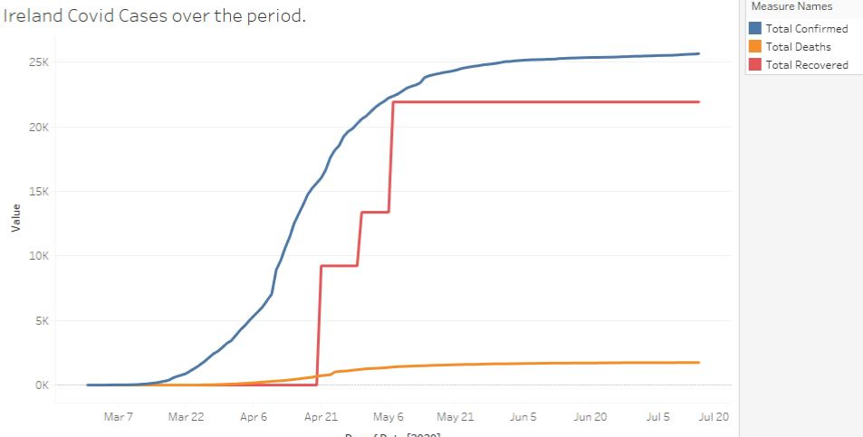
Ireland Covid-cases over the period of time
Trend observed in Ireland’s COVID-19 related statistics

Slide 20
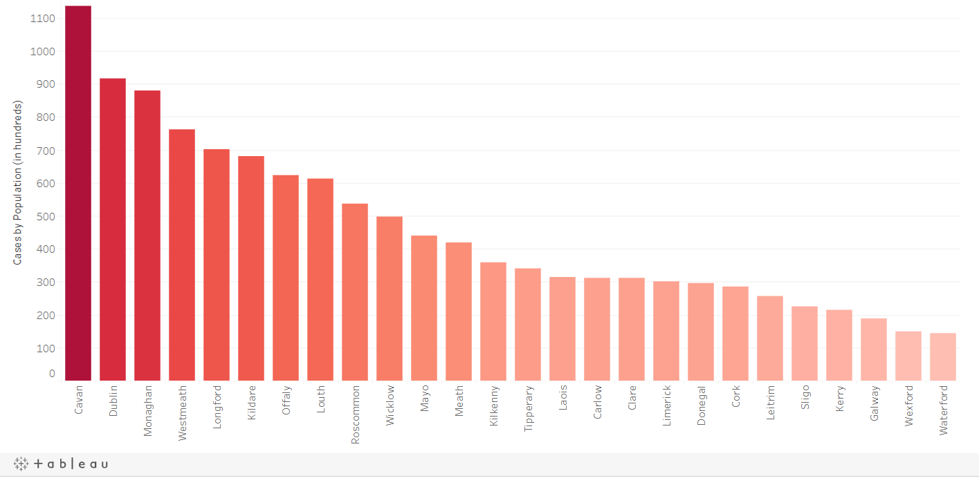
The previous slide’s Data would be used for Trend Visualizations as much mentioned before.
County-wise Cases by population.

Slide 21
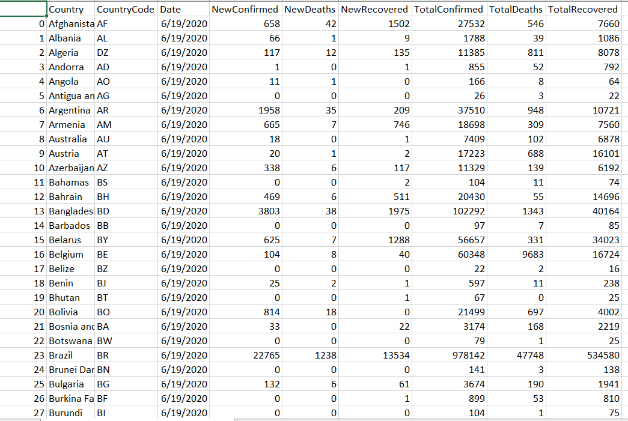
This is the summarized data which provides us with 6 counts: New Confirmed, New Deaths, New Recovered, Total Confirmed, Total Deaths, Total Recovered for all countries on the date of visit.

Slide 22
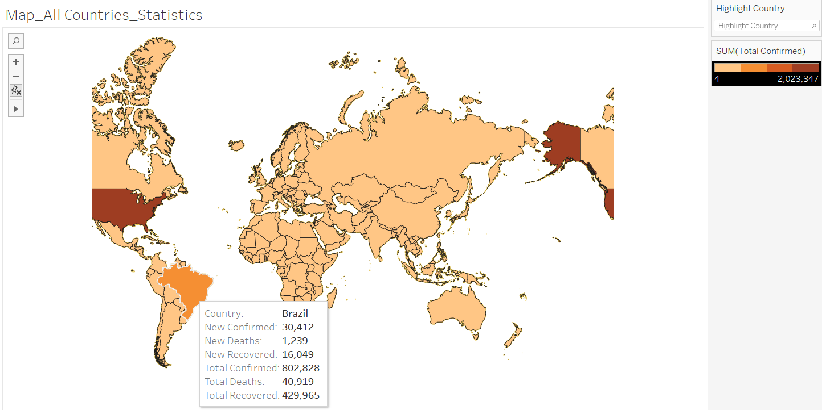
When we hover over a country, we’d be provided with the statistics for that country. Also, the intensity of the colour used increases as the count of Total Confirmed cases increase. We can see, USA has been assigned the darkest shade possible in the range. You can see the colour shade used on the top-right most side of the picture.

Slide 23
STAY SAFE!
THANK YOU!
-Team Rocket

